Slide 1

Time series data analysis and forecast methods
Lecture 6
Adaptive time series data analysis

Slide 2

Lecture map
Definition of adaptive time series analysis
Non-stationary time series data analysis
Singular Spectrum Analysis (SSA) method
Wavelet Decomposition and Wavelet Packet Decomposition (WPD)
Empirical Mode Decomposition (EMD) and modifications (EEMD, CEEMD)
Spectrogram methods for time-frequency characteristics estimations
Other methods for time-frequency characteristics estimations

Slide 3
PART 1. ADAPTIVE DATA ANALYSIS OF NON-STATIONARY TIME SERIES

Slide 4
Non-stationary time series
All of the discussed methods are for the stationary or quasi-stationary time series data;
The real data is almost never stationary, thus having parameters and characteristics of its components as functions of time;
To represent this varying with time parameters we need the so-called instantaneous values;
This point of view is called Time-and-Frequency representation of characteristics.

Slide 5
Non-stationary time series
Set of non-stationary processes and set of processes with varying time-and-frequency characteristics are not the same;
The equivalency between these two sets theoretically is still not proved;
However, it is evident, that any non-stationary time series data has a varying time-and-frequency characteristics;
The inverse statement is not always true.

Slide 6
Adaptive time series analysis
These types of methods do not require a stationarity property from time series. These methods simply do not require any kind of a priori information about the analyzed data.
There are also some modifications of well-known methods with variable parameters, which are adapting to the form of analyzed time series.

Slide 7
PART 2. SINGULAR SPECTRUM ANALYSIS (SSA) METHOD

Slide 8
Singular Spectrum Analysis – SSA
«Caterpillar»-SSA method.
Decomposition stage:
Embedding step;
Singular value decomposition (SVD) step;
Reconstruction stage:
Grouping step;
Diagonal averaging step.

Slide 9
Decomposition stage
Input data:
Time series:
Window size L: ->
1) Embedding step:
Creation of L-trajectory matrix X

Slide 10
Trajectory matrix

Slide 11
Decomposition stage
2) Singular value decomposition:
Eigen-values:
Eigen-vectors:
Let &
Then , where

Slide 12
Eigen-triple
The collection of:
Eigen-value
Eigen-vector
Trajectory vector

Slide 13
Reconstruction stage
3) Grouping step:
Regroup the initial set {1, …, d} of indices into m disjoint subsets
These subsets have their own eigen-triples with group matrix
The grouping of these new matrices leads to a new decomposition:

Slide 14
Grouping step
Simple explanation:
Before the grouping step:
X = a + b + c + d + e + f + g + h
After the grouping step:
X = (a) + (b + c) + (d + e) + (f + g + h)
X = g0 + g1 + g2 + g3

Slide 15
Reconstruction stage
4) Diagonal averaging:
Transform each matrix of the grouped decomposition into a new time series;
Let
if and – otherwise
Reconstructed time series is:

Slide 16
Diagonal averaging

Slide 18
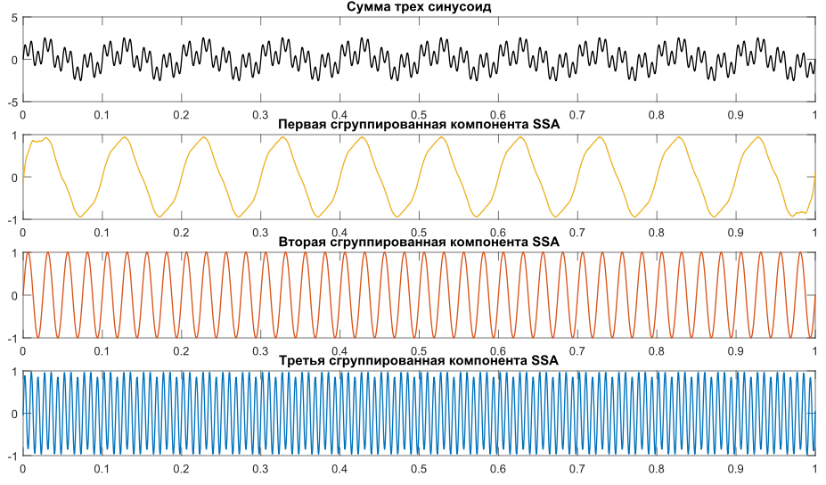

Slide 19
Separability for the SSA method
Grouping step is closely connected to the separability measure of time series;
With strong separability SSA method can only separate constants from harmonic components;
With asymptotic separability SSA method can separate everything except the long-term tendencies;
With approximate separability SSA method can decompose everything, but the accuracy is proportional to the

Slide 20
How to choose grouping indices
The higher the value of eigen-value, the higher the contribution of the corresponding component to the total energy of process;
Harmonic eigen-vectors generate trigonometric components;
Singular eigen-triples diagrams with regular form or pattern have a higher chance for a mutual grouping between each other;

Slide 21
How to choose grouping indices

Slide 22
How to choose grouping indices
Each trigonometric component has at least two eigen-triples;
Each cycle or season consists of components with approximately equal period;
Trend has a high quantity of eigen-values with slow-changing eigen-vectors;
All of the residual indices – to the one residual data = noise, error, etc.

Slide 23
How to choose grouping indices
Eigen-values are always in descending order:
Single big eigen-values are related to trend
Double paired almost equal eigen-values are related to seasons;
Close numerically eigen-values are related to modulated cycles;

Slide 25
How to choose the window L
There is no meaning to choose window length L larger than half of time series length N;
The more the window L – the more basic components you will get, and the more detailed decomposition is built;
Too small window L can lead to the mode mixing;
In order to separate the periodic component with higher accuracy, it is essential to choose the window L as a multiple of this period;

Slide 26
Eigen-values difference technique
For the initial time series window L is chosen between 10-20 time samples to the half of N;
For each corresponding value of L the difference between consecutive eigen-values is calculated:

Slide 27
Eigen-values difference technique
Plot these differences as functions from window L for every pair of consecutive eigen-values:
Analyze these plots

Slide 29
Eigen-values difference technique
The window L is chosen by the minimization of the difference between consecutive pair of eigen-values, considering all of them together;
Periodic components will have the same period, as the plotted functions;
The consecutive pair of eigen-values, which are not for grouping, will have non-periodic form of monotonic functions;

Slide 30
PART 3. WAVELET DECOMPOSITION OF TIME SERIES

Slide 31
Continuous Wavelet Transform CWT
Wavelet transform is very similar to the Fourier transform with some adjustments:
where a – scale, b – translational value, – the mother wavelet or wavelet basis function.

Slide 32
Inverse Transform
This formula can be interpreted as:
method for the reconstruction of the initial time series based on its wavelets,
method for time series notation in time-and-frequency representation.

Slide 33
Discrete Transform DWT
Everything depends on basis wavelet;
Second formula = discrete signal filtering.

Slide 34
Decomposition technique
Procedure of the iteration filter scheme based on orthonormal basis wavelet functions:
Initial time series x(t) passes through the low-pass filter with impulse response g, and through the high-pass filter with impulse response ℎ, leading to the convolution product;
Those filters are linked with each other, and they are called Quadrature Mirror Filters QMF;

Slide 35
Decomposition technique
Because half of the frequency band was filtered, due to the Nyquist–Shannon sampling theorem we can decimate the time series by downsampling;

Slide 36
Decomposition technique
From this convolution product we receive two results:
Detail coefficients cD (after high-pass filtering);
Approximation coefficients cA (after low-pass filtering)

Slide 37
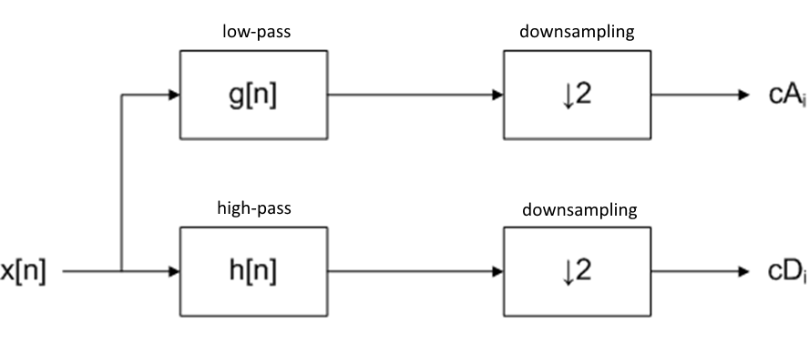

Slide 38
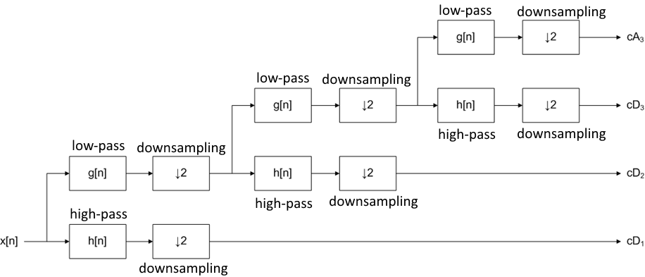

Slide 39
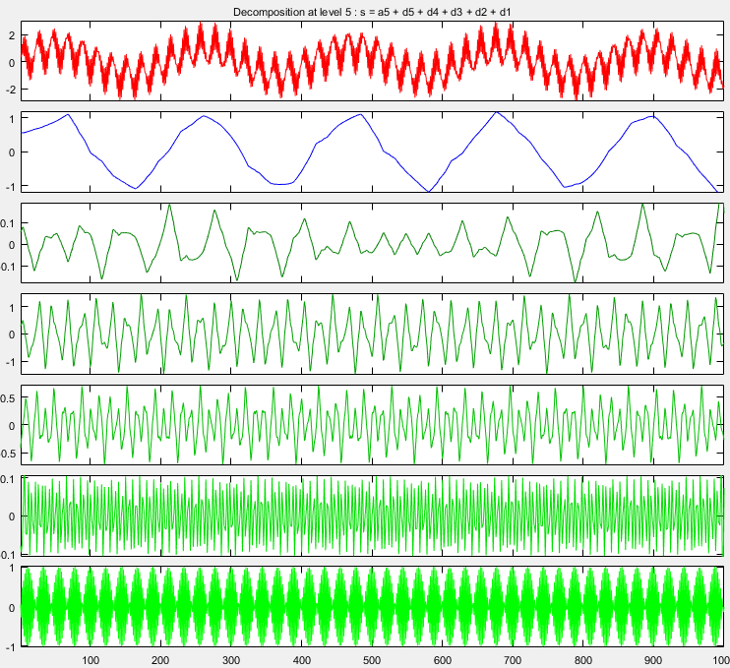

Slide 40
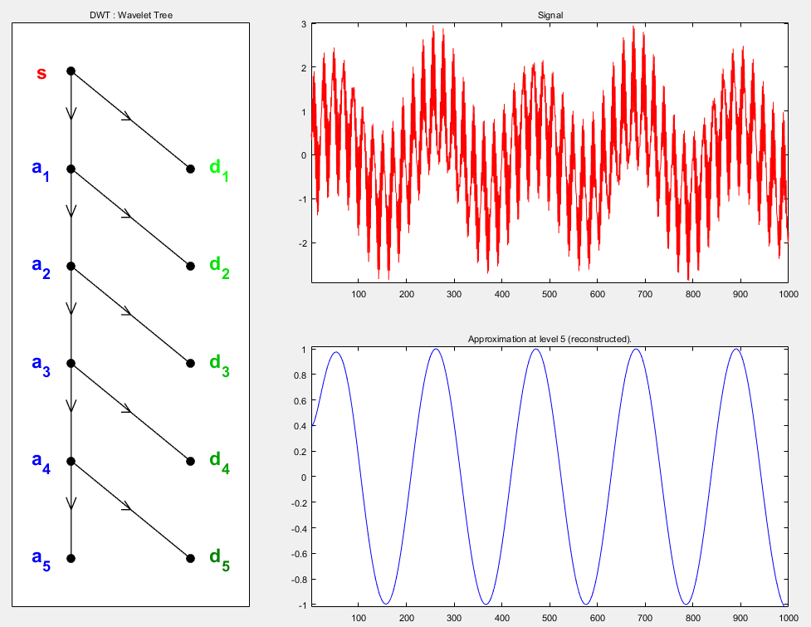

Slide 41
Wavelet Packet Decomposition WPD
Repeated convolution and filtering can be applied not only to the detail coefficients cD, but to the approximation coefficients cA as well, thus leading to the reconstruction of the full binary tree.
From this full binary tree we can choose only one branch with the highest value of estimated entropy.

Slide 42
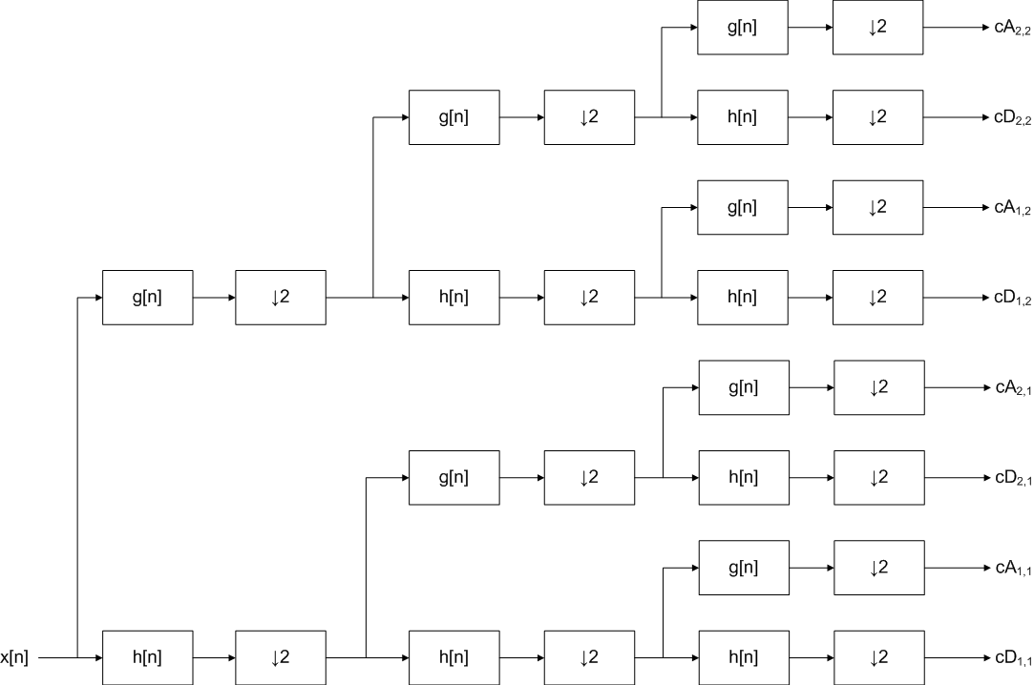

Slide 43
Wavelet Packet Decomposition
Basis mother wavelet is chosen in such manner, that its derived wavelets can be calculated even before the binary tree reconstruction;
Scale and translational value are chosen adaptively, in order to achieve the decomposition with the highest accuracy;

Slide 44
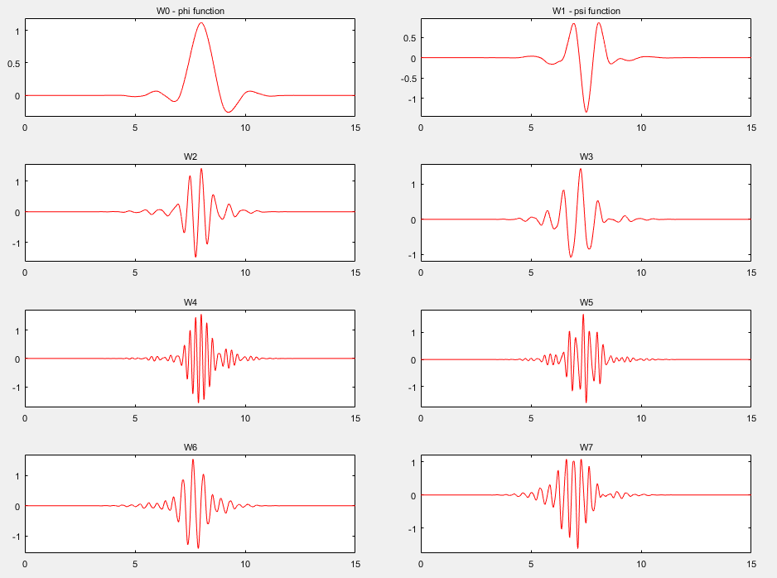

Slide 45
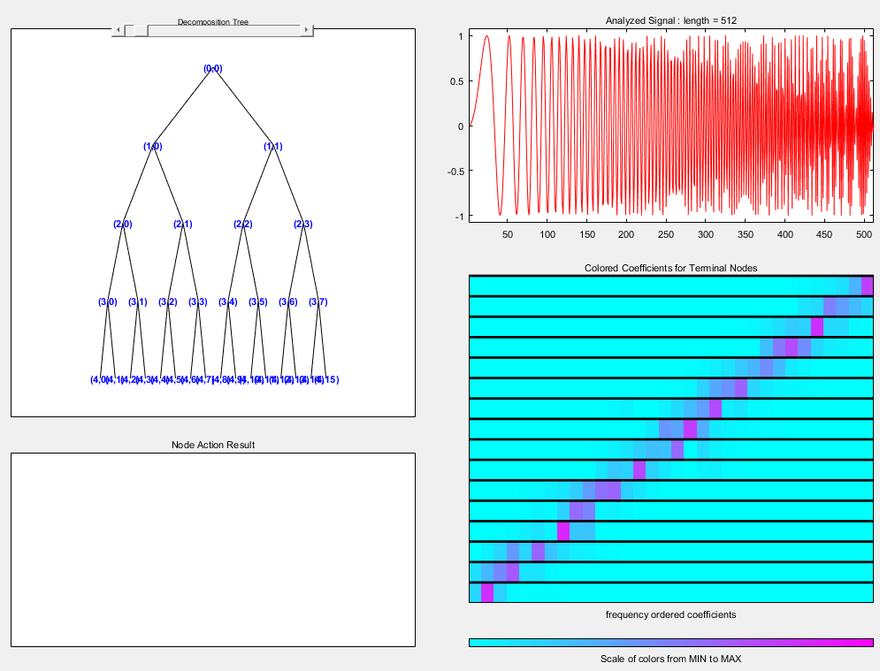

Slide 46
PART 4. EMPIRICAL MODE DECOMPOSITION

Slide 47
Empirical Mode Decomposition = EMD
Empirical Mode Decomposition (EMD) is very identical to the idea of SSA method:
Any time series can be decomposed into an additive model with deterministic modes c_{i} and residual stochastic data r_{n}

Slide 48
EMD procedure
Search out all of the max and min points of the initial time series data;
Build the two enveloping interpolating curves with splines, passing through these maximum and minimum points of the time series;
The upper curve (passing through the maximums) is noted as U, the lower curve (passing through the minimums) is noted as L.

Slide 50
EMD procedure
Estimate arithmetical mean curve m=(U+L)/2;
Remove this mean curve from data r=u(t)-m;
Repeat previous steps for ten times (until this arithmetical mean curve m is not close to zero);
The final residue r is accepted as the found component or intrinsic mode

Slide 51
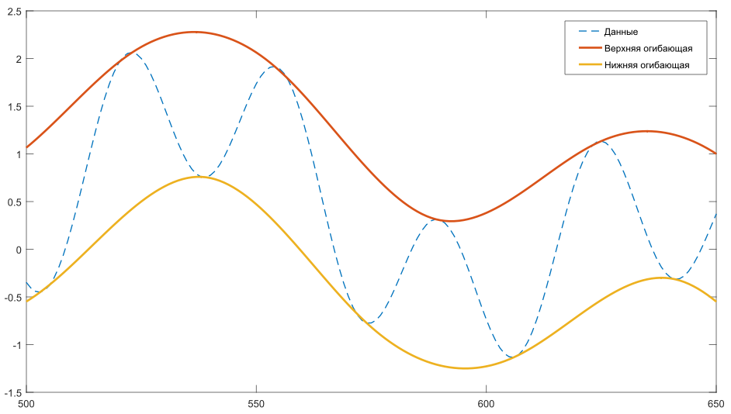
First step

Slide 52
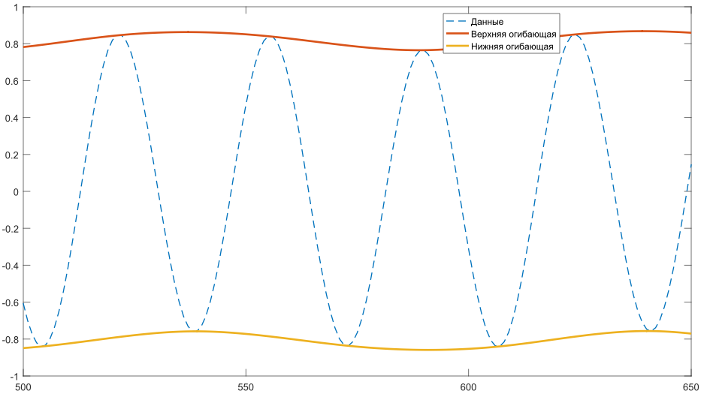
Second step

Slide 53
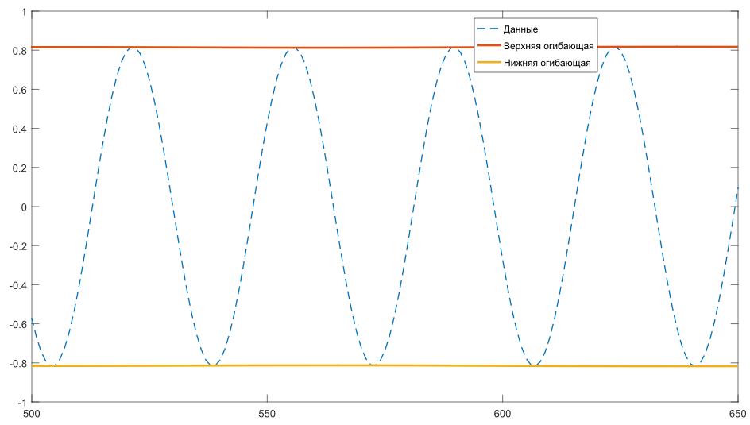
… step

Slide 54
EMD procedure
This found mode c_{i} is removed from time series;
The residual (u(t) – c_{i}) denoted as the new time series u’(t) to decompose iteratively with the previous steps of EMD procedure;
The overall decomposition is repeated until the n-th residual is achieved, where n=[log₂N+1].

Slide 55
Second component

Slide 56
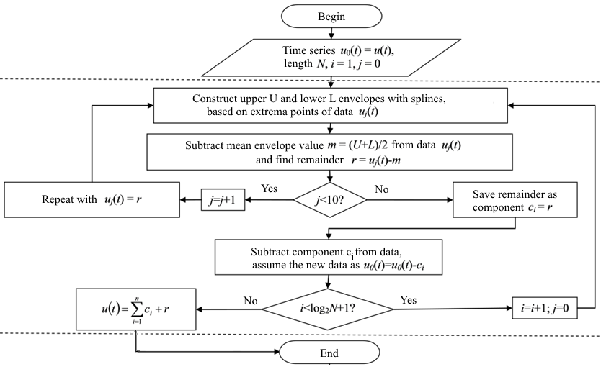

Slide 57
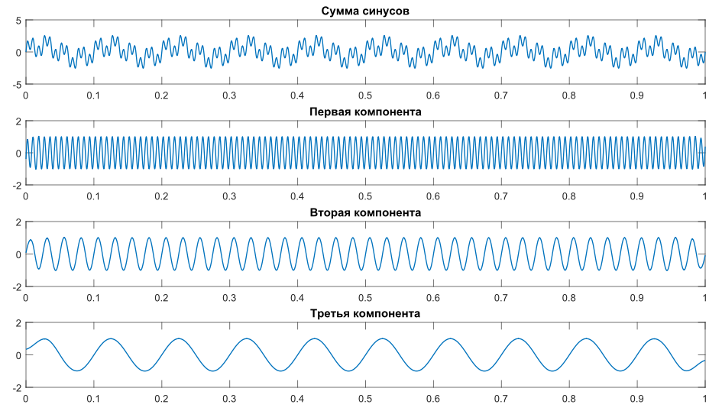

Slide 58
Mixing modes problem
The strong separability is unattainable if the initial time series has a considerable noise;
The found modes/components are distorted due to the mixing of frequency bands;
The residual stochastic time series data does not qualifies as a random variable with statistical tests;

Slide 59
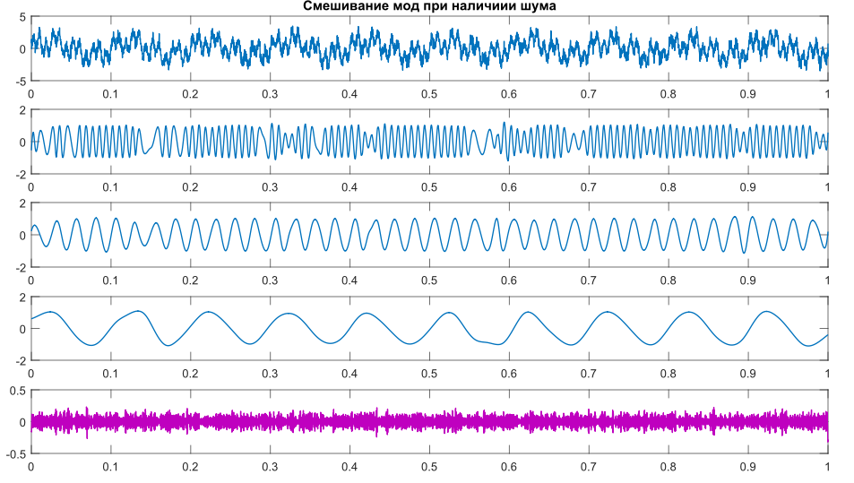

Slide 60
Ensemble Decomposition
Ensemble EMD = EEMD
With usage of Monte-Carlo technique we can recreate the set of samples from one time series;
In order to achieve this we add the white Gaussian noise (wGn) to the initial data on every iteration of EMD algorithm;
Therefore, the final modes are not distorted and mixed due to the ensemble filtering and averaging procedure;

Slide 61
EEMD modification
For time series u(t) of length N find the total number of modes as n=[log₂N+1];
Normalize the initial time series:
Determine the two input parameters: the ensemble number N_{E}, and the added signal-to-noise ratio SN_{E}
Default values:

Slide 62
EEMD modification
Add to the normalized data a noise sample with the known signal-to-noise ratio SN_{E};
Decompose this time series with EMD;
Repeat these steps N_{E} times. On every iteration of this outer cycle the decomposition is saved, and the noise sample is re-generated;
Ensemble averaging procedure is then used on the achieved decomposition, and then the final modes are denormalized.

Slide 63
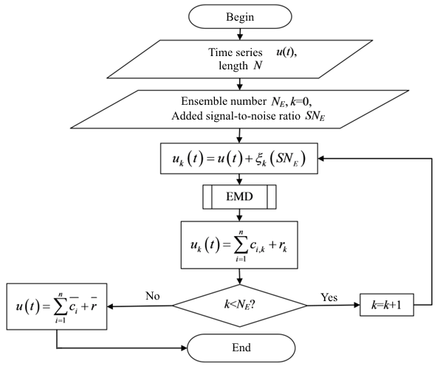

Slide 64
CEEMD modification
Complementary EEMD = CEEMD
We save two sets of resulting components:
With “plus” added noise sample;
With “minus” added the same noise sample;
The final ensemble averaging would be much more accurate and precise due to the symmetry.

Slide 65
PART 5. TIME-FREQUENCY CHARACTERISTICS OF NON-STATIONARY TIME SERIES

Slide 66
Spectrogram
The simple Fourier transform (and all the derivative spectrum methods) has a fixed frequency resolution, and the frequencies are integrated throughout all of the time interval;
However, with window convolutions we can decompose the time series into small time spans with quasi-constant frequencies, thus reconstructing the time-and-frequency characteristic of time series data.

Slide 68
Instantaneous frequency
What if there is a method to show the function between the season/cycle period/frequency and instant current time moment?
Then in every defined time point we can observe the value of period or frequency of mode, reconstructing the time-and-frequency representation of initial time series;
Those observations of period and frequency in any given instant time point are called instantaneous period and instantaneous frequency;

Slide 69
Analytical signal
H(u) – Hilbert Transform operator
With the introduction of analytical signal w(t) with the help of Hilbert transform H(u), we can calculate any instantaneous characteristic as a function of time.

Slide 70
Instantaneous values
Enveloping curve (amplitude modulation):
Instantaneous phase:
Instantaneous frequency:

Slide 71
Time-and-frequency presentation
Decompose the initial time series adaptively;
Reconstruct the analytical signal for every found mode with Hilbert Transform conjugation;
Estimate the instantaneous values with equations;
Differentiation of instantaneous phase gives us the instantaneous frequency, and, thus, the instantaneous period (T=1/f ) as a function of time;
Smooth all the final time-and-frequency functions, due to differentiation errors.

Slide 72
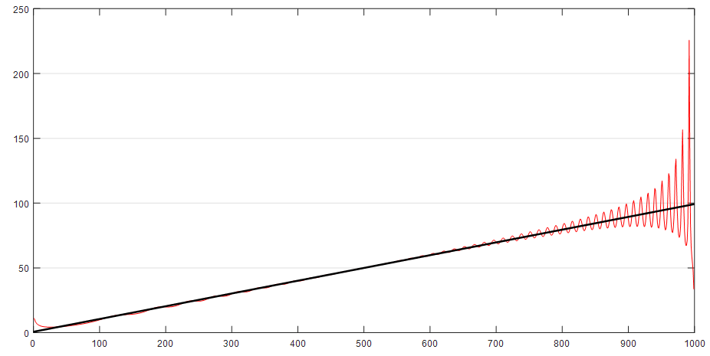

Slide 73
Direct Quadrature
We can estimate the analytical signal empirically;
Create the time series of absolute values of initial data;
Create the enveloping curve with cubic splines, passing through the maximums, the same as we did it in EMD;
Divide the initial time series by this enveloping curve;
Repeat this normalization, until
Estimate the amplitude modulation as
Estimate the Direct Quadrature as
Estimate the instantaneous frequency as a differentiation of phase .

Slide 74
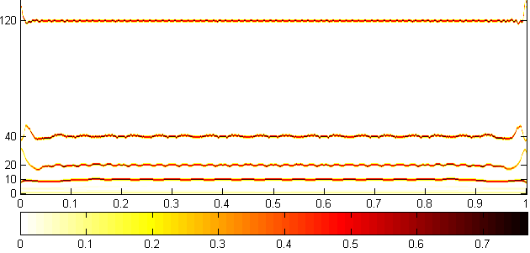

Slide 75
References
Golyandina, N., A. Zhigljavsky. Singular Spectrum Analysis for time series. — Springer Briefs in Statistics. — Springer. — 2013. — 120 p.
Amara Graps. An Introduction to Wavelets, IEEE Computational Sciences and Engineering. — Vol. 2. — No 2. —1995. — pp. 50-61.
Huang N. E. The Hilbert-Huang transform and its applications. Interdisciplinary mathematical sciences: World Scientific Publishing Company Co. Pte. Ltd. — 2005. —311 p. ISBN: 9812563768.
Huang N. E., Wu Z., Long S. R. On Instantaneous Frequency. — Advances in Adaptive Data Analysis. 2009. — 53 p.
Yeh J.R., Shieh J.S., Huang N.E. Complementary Ensemble Empirical Mode Decomposition: A Novel Noise Enhanced Data Analysis Method. — Advances in Adaptive Data Analysis. — 2010. — Vol. 2. — No 2. — pp. 135–156.
Bedrosian, E. (December 1962), A Product Theorem for Hilbert Transforms, Rand Corporation Memorandum (RM-3439-PR) https://www.rand.org/content/dam/rand/pubs/research_memoranda/2008/RM3439.pdf

